Slide 1

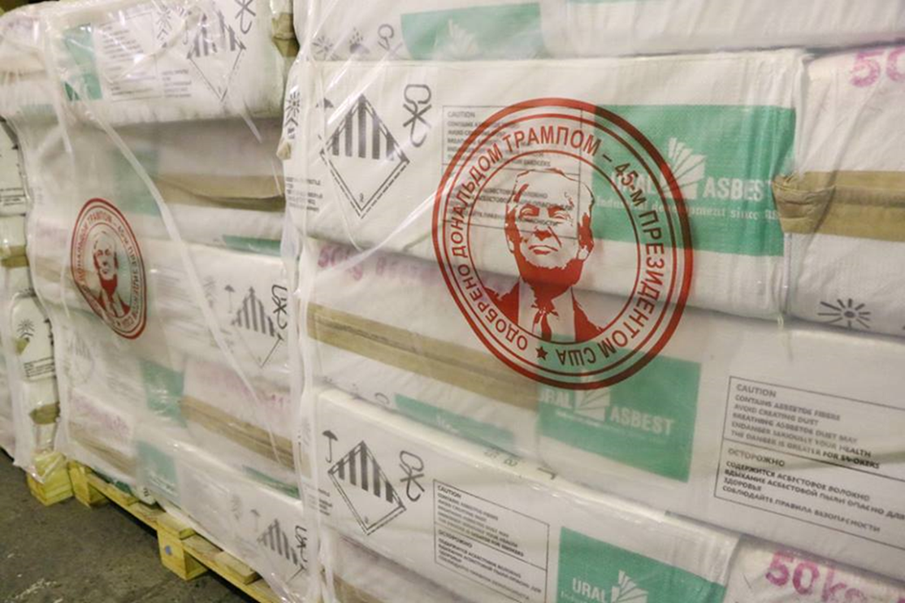

Notes:
The Asbestos. Not Here. Not Anywhere. campaign is the priority campaign of Union Aid Abroad – APHEDA. The goals of the campaign are to win national asbestos bans in Cambodia, Indonesia, Laos and Vietnam, to support regional and global moves to ban asbestos, and to end illegal asbestos imports into Australia. 2018 saw some big wins for the campaign, but the opposition from countries and companies that have a financial stake in the trade and production of asbestos has only got more fierce.
Donald Trump is known to be sceptical of the danger of asbestos. In 2019 a Russian asbestos firm put his face on their packages of raw asbestos with the phrase ‘approved by the 45th president of the United States’.

Slide 2
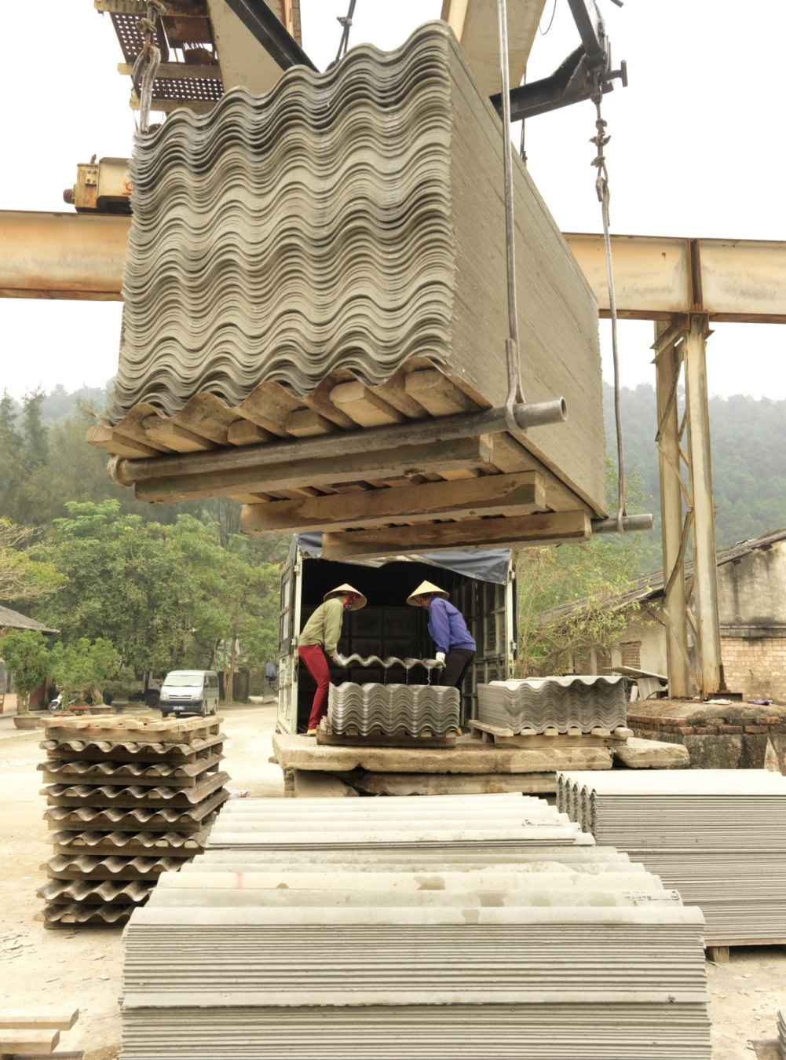
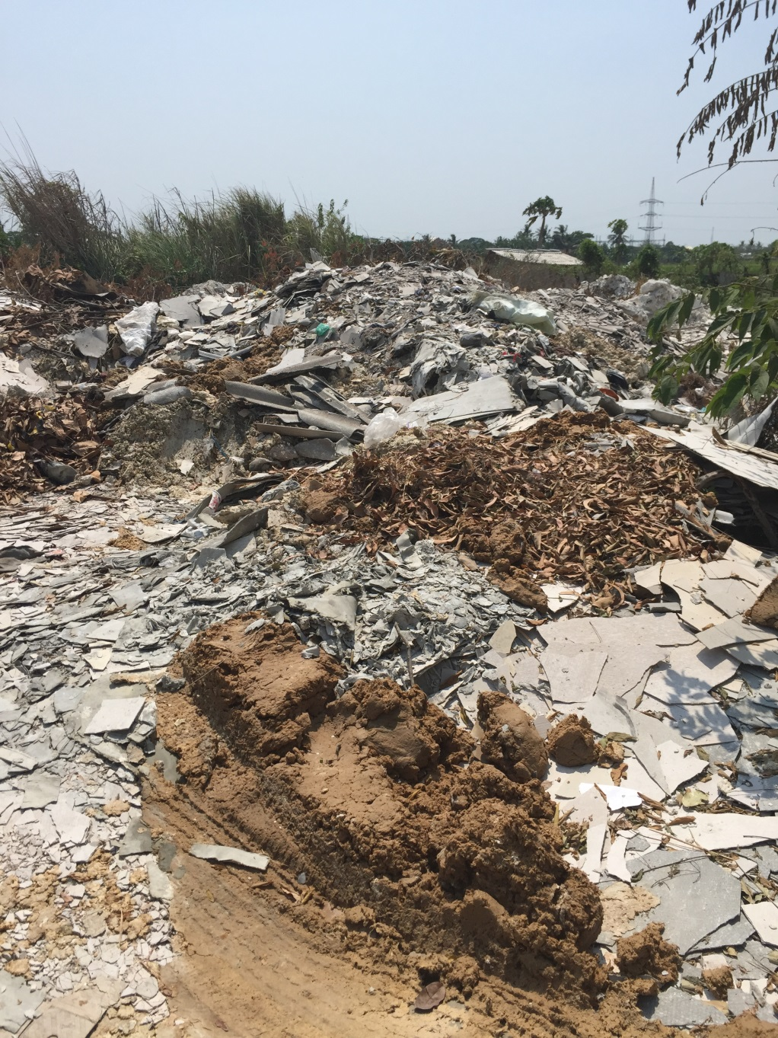
Notes:
Each year, approximately 2 million tonnes of raw asbestos are mined in the few remaining asbestos producing countries, primarily Russia and Kazakhstan. Many Australians think that the fight against asbestos has been won and would be shocked that countries in our region are still manufacturing construction materials and other products with it, and even more shocked that workers and communities are being told that it’s safe.
Image on the left is at a roof sheet factory in Vietnam
Image on the right is dumped asbestos waste near a factory in Indonesia

Slide 3
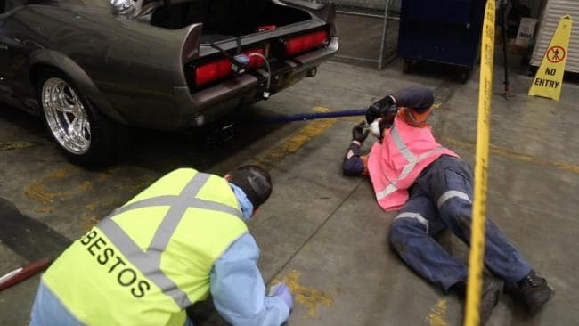
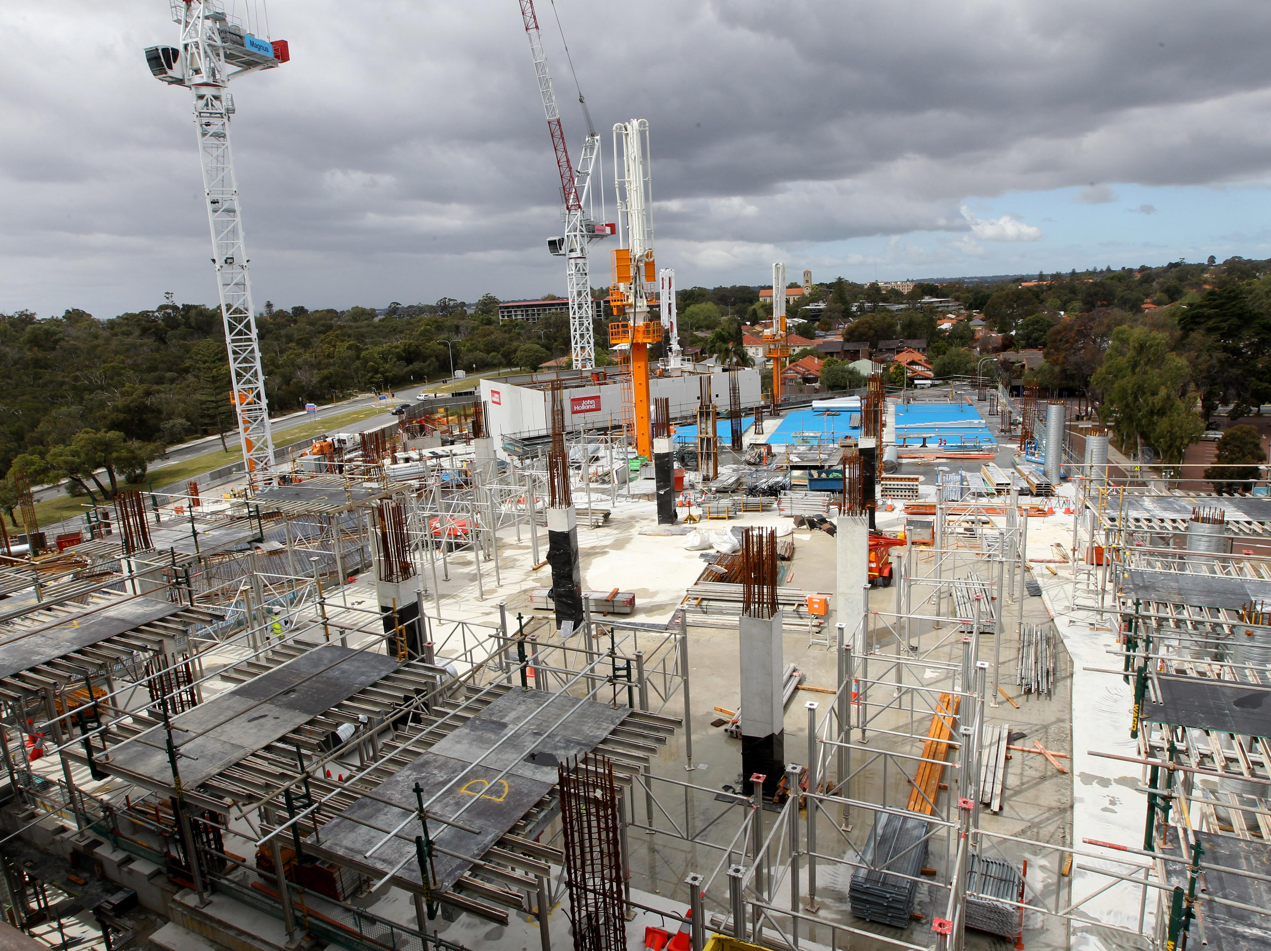
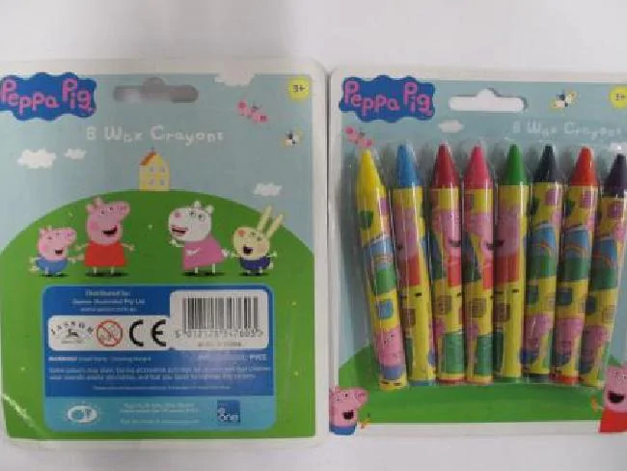
Illegal asbestos imports
Notes:
Australia banned the mining, trade and manufacture of asbestos in 2003 and it’s illegal to import raw asbestos or asbestos products. However, dozens of illegal asbestos imports are stopped at the border each year, and some make it into Australian workplaces and homes. The illegal imports are often building or transport products, as in the case of 200 Asbestos cement sheets imported for installation in the Perth Childrens Hospital in 2016 or the 3500 train carriages containing asbestos imported from China for use in Western Australian mining. But there are other products that you wouldn’t expect to contain asbestos, like the Dora the Explorer, Peppa Pig and Frozen crayon sets imported in 2015. While asbestos is mined, manufactured and traded overseas, it will continue to be illegally imported into Australia. That’s why we say asbestos, not here, not anywhere.

Slide 4
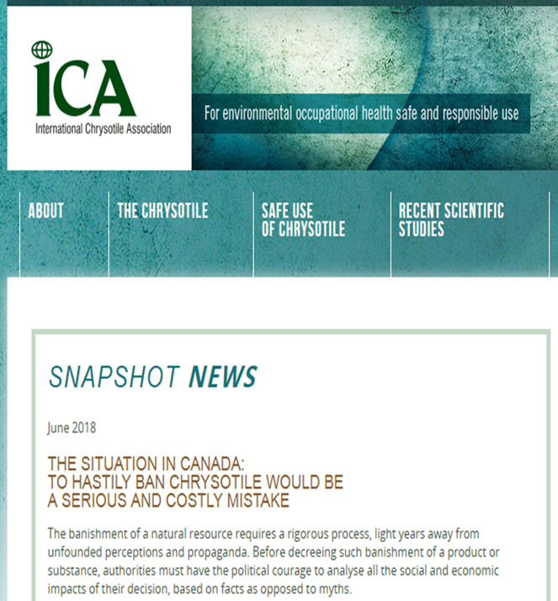
Who are the asbestos lobby?
Notes:
What we call the Asbestos Lobby is a group of industry associations around the world that lobby and advocate for the continued use of asbestos. One of the global organisations is the International Chrysotile Association.
Asbestos Lobby Tactics:
Set up offices – they claim to have offices or representatives in 8 locations in Asia
Block listing of chrysotile (white) asbestos on the international Rotterdam Convention for hazardous chemicals.
Deny the facts - campaign of lies misinformation, intimidation
Commissions ‘experts’ to mislead governments and the medical community.
Target political power to delay bans
Discredit the World Health Organisation and Union Aid Abroad - APHEDA
Weaken/silence ban groups – tactics include hiring spies & litigation against campaigners
Promote the International Alliance of Trade Union Organizations "Chrysotile“, The International Chrysotile Association and the Chrysotile Information Centre who take the position that chrysotile asbestos is an absolutely safe material when used according to standard procedures of controlled use.

Slide 5
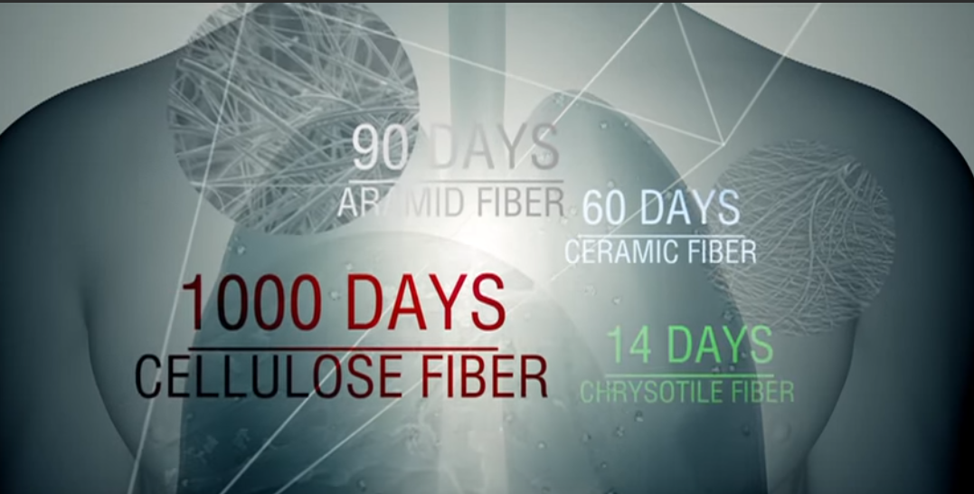
“Safe asbestos”
Notes:
The asbestos lobby claims that chrysotile asbestos dissolves in the lungs in 14 days and that alternative products are more dangerous. This image is from a YouTube video in a series promoting the safe use of asbestos.

Slide 6
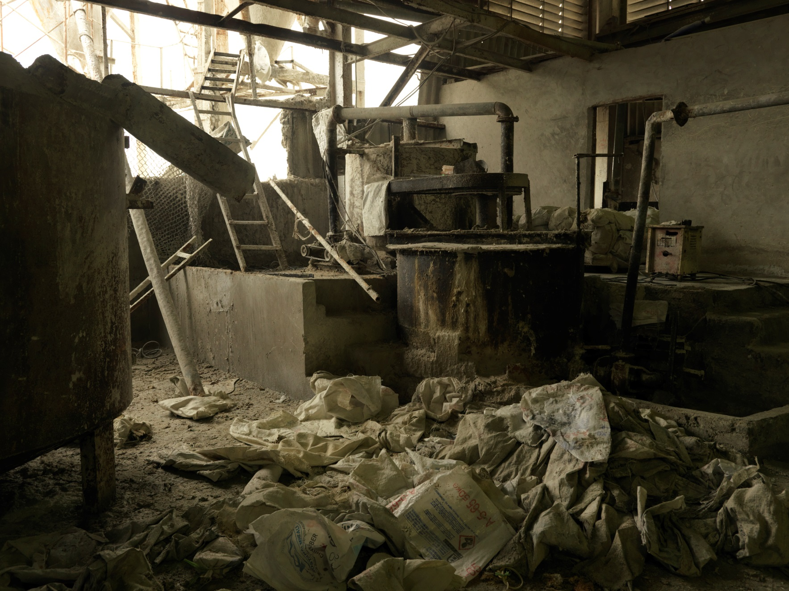
Notes:
We hear from workers in Vietnam, Indonesia, Laos and Cambodia, as well as other countries that still use asbestos, about the low safety standards in their workplaces. This is a photo from a roof sheet factory in Vietnam. We’ve even spoken to Indonesian workers who would have their lunch next to open bags of raw asbestos and weren’t told of the danger.

Slide 7
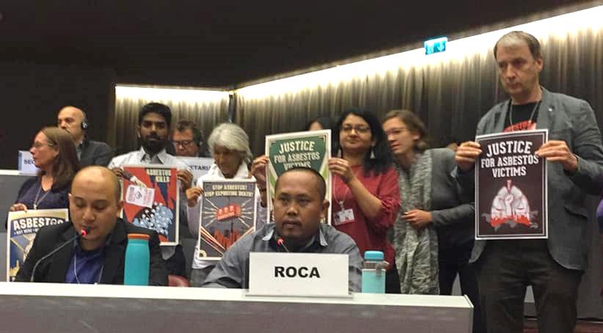
Notes:
Campaigners across the world are fighting back and winning real progress against the Asbestos Lobby and Industry. In all the countries we work in there is training to increase awareness for the dangers of asbestos and support for the unions, activists, workers and NGOs that are building support for asbestos bans. From Geneva to Java, workers in Asbestos factories are speaking out about their conditions and why they need safe workplaces and communities.
Pictured speaking is Subono from SERBUK union in Indonesia who represent workers in asbestos factories. Subono used to work in a factory manufacturing asbestos products and has seen many of his former workmates fall victim to lung cancers and disease.

Slide 8
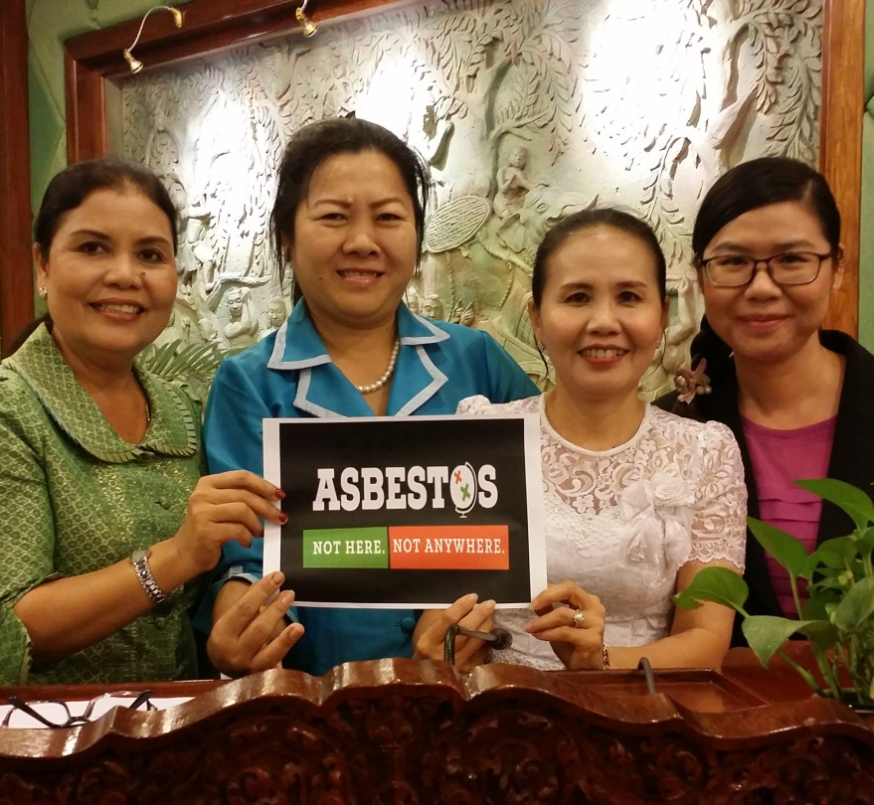
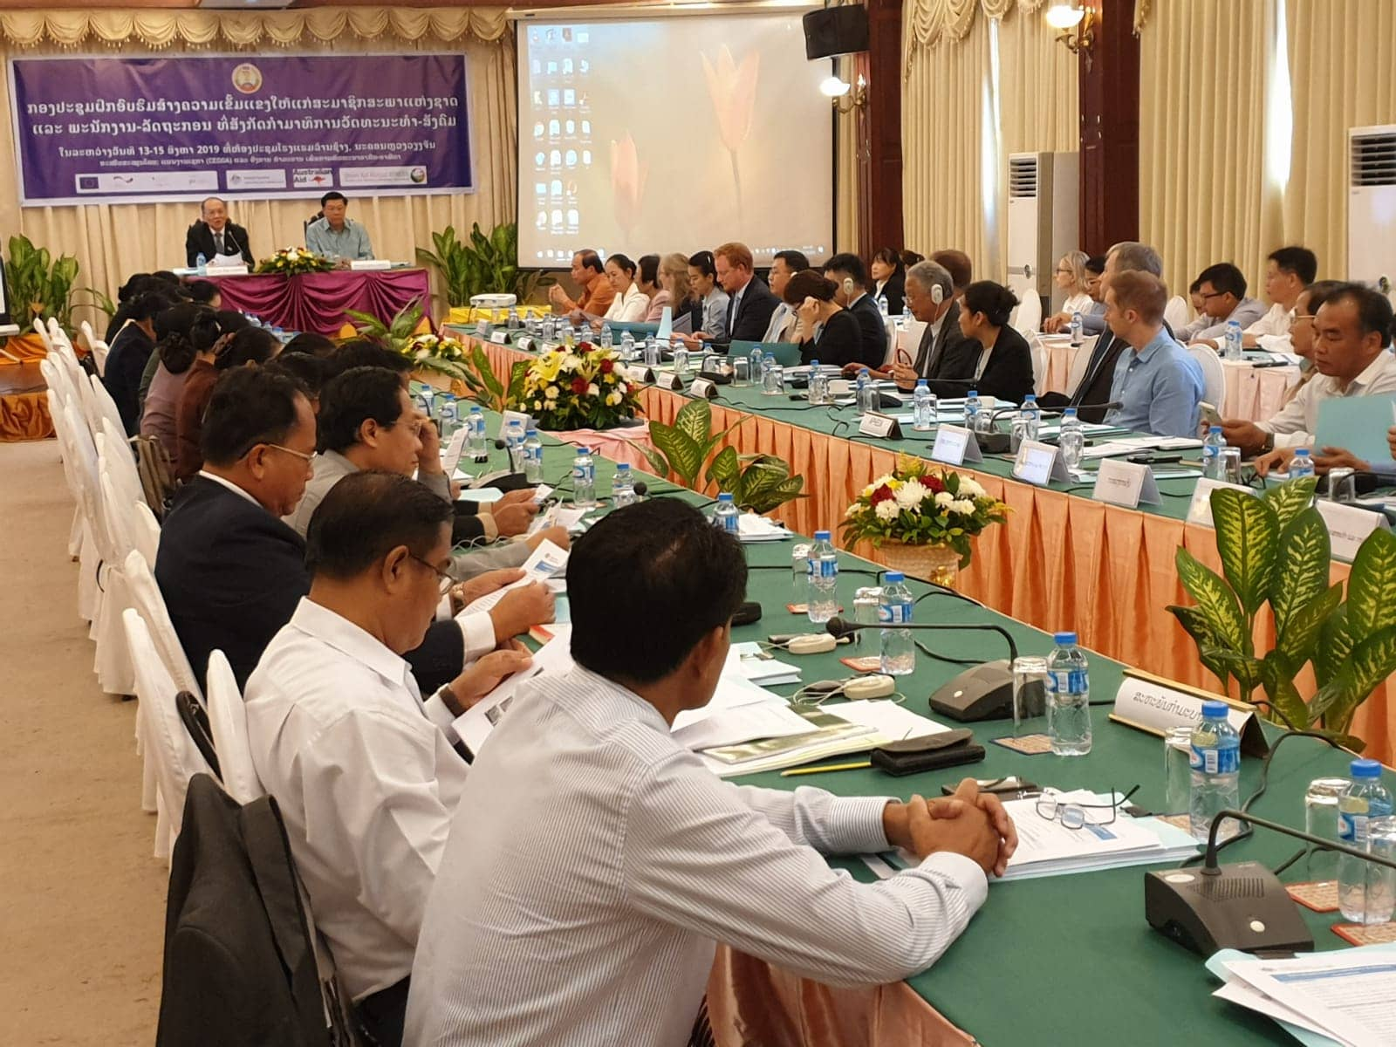
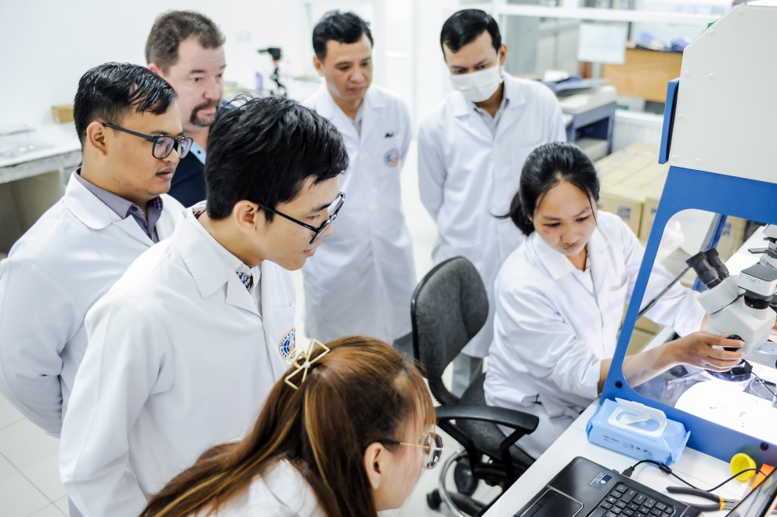
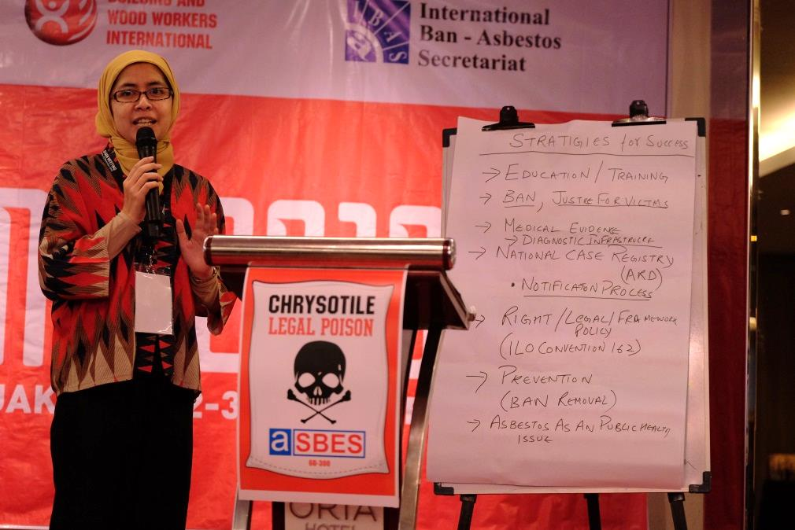
Notes:
Union Aid Abroad – APHEDA works across the Asia Pacific with our partners by supporting training, increasing awareness of the dangers of asbestos, working with Ban Asbestos Networks, supporting workers who are winning safer workplaces and by building international solidarity.
Clockwise from top left: Women from the Cambodian Ministry of Labour, National Assembly Members meet in Laos to discuss banning asbestos in August 2019, International campaign training session in Indonesia, Microscope training and handover in Cambodia

Slide 9

Notes:
No Australian or international development funds should finance asbestos overseas.
Australians understand the toxic legacy of asbestos and we can take a leading role in standing up for sustainable and healthy development. We can make sure that no Australian development funds or any humanitarian aid leaves behind a deadly health disaster.
We’re running a campaign to stop International Development Banks funding asbestos products. We’ve successfully worked with unions, politicians, activists and asbestos diseases victims groups in Australia to pressure the government to take a stance on the Asian Development Bank (ADB) funding asbestos products. By also working with international allies we won a change in policy that means the $10 billion USD a year that the ADB funds won’t be allowed to be used for asbestos products.
We’re working on expanding this win to other banks and international organisations to make sure no international development funding supports the asbestos industry. Keep an eye on our website for the most up to date actions.

Slide 10
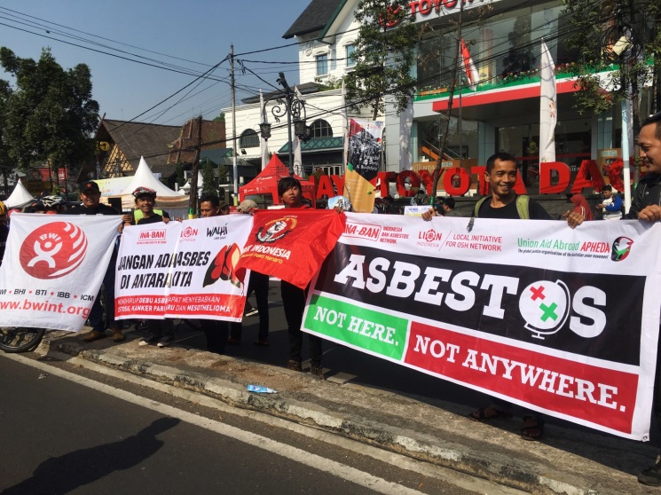
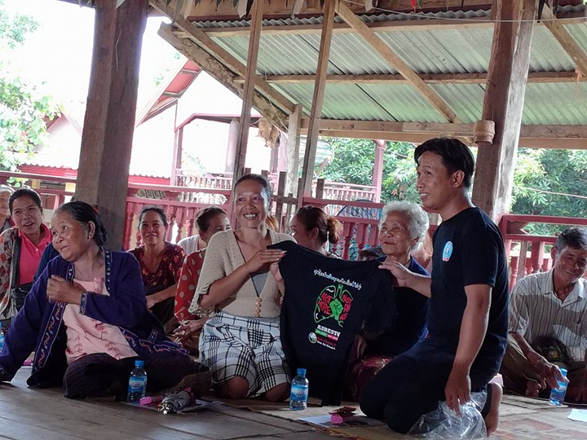
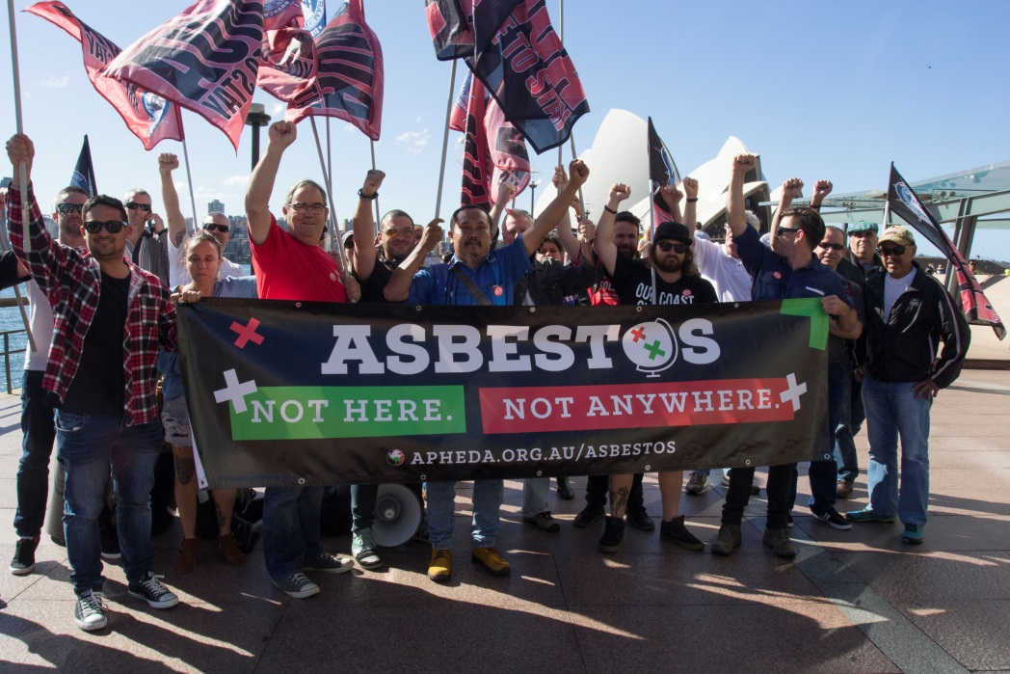
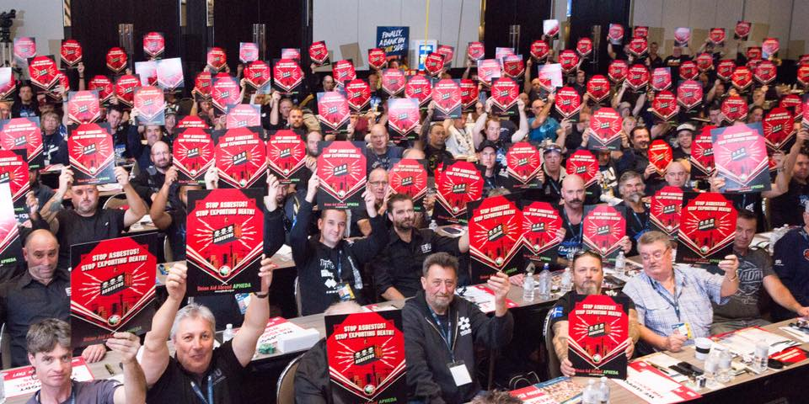
Support Union Aid Abroad – APHEDA and our partners campaigning for an end to asbestos
Notes:
Joining Union Aid Abroad – APHEDA means that you’re part of the global fight for workers rights, gender equality and climate justice. Becoming a member for $15 a month supports the work of our partners who are organising for asbestos bans, training workers and advocating for the rights of vulnerable communities. If you believe that workplaces and communities around the world should be safe from asbestos then you can join APHEDA to become part of the campaign. If you’re already a member then please consider increasing your donation. If all of our members on $15 a month increased to $20 or $30 a month we can put even more resources into challenging the lies of the asbestos industry. You can be part of the movement for global solidarity by joining Union Aid Abroad – APHEDA today.

